Slide 1
AP Movie: Primary colors
Elections and Campaigns by Mike Nichols

Slide 2
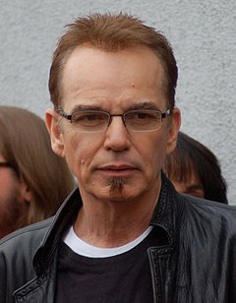
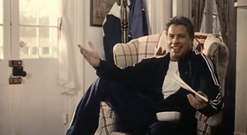
Some of the Stars

Slide 3
Roles of The Stars
Billy bob thornton: Richard Jemmons (Consultant)
Emma Thompson: Susan Stanton- “AKA” Hillary Clinton
John Travolta: Jack Stanton, “AKA” Bill Clinton.

Slide 4
Synopsis
Mike Nichols is a Thinly veiled Account about the 1992 Campaign of Bill Clinton and the people in his campaign including Hillary Clinton. In the movie it discusses how the media influences campaigns. It also discusses how the American media have an insatiable desire for Political Intrigue, which leaves it wide open to manipulation by skilled political operatives.

Slide 5
Pay close attention to who you find to be the most compelling/interesting character. Discuss why?

Slide 6
What “Character Test” is Delivered in the movie?

Slide 7
What is Galloping TB? Hint: It’s not Tuberculosis!

Slide 8
What does the Krispy Kreme scene reveal about Jack Stanton’s (Clinton’s) Character?

